Slide 1
Methodology Outline
PRESS 2022

Slide 2
4 Steps to a comprehensive classification
Reading the CRS data
Preparing the data
A: Title pattern matching
3.1 Minority language treatment
B: Text mining of long descriptions
4.1 Technical aspects of text mining
4.2 Performance checks

Slide 3
1. Reading the CRS data
After downloading all .txt files for years 2006 - 2020 from https://stats.oecd.org/DownloadFiles.aspx?DatasetCode=CRS1 ,
fully merged data set is stored as a .rds file.

Slide 4
2. Adding unique text identifiers
Unique text id’s are used in the process to reduce computation time since only unique titles and long descriptions are processed and later joined to full data set acc. to text id’s
Reduced CRS data
Full CRS data
projecttitle
longdescription
title_id
text_id
descr2mine
Identifiers (scb, pop, gen_donor…)
….
1. Text cleaning
2. Id creation
3. descr2mine
4. Creating identifiers
Text cleaning: numbers & punctuation removed, all lowercased
Id creation: unique title/description identifier through hashing of strings using xxHash (see https://github.com/Cyan4973/xxHash for details), outputs string of length 8
descr2mine: use only distinct long description (that differ from title) for text mining, compare description with title by counting number of alterations that would be needed to get to the title string (see Damerau-Levenshtein-Distance for details) -> if the string distance is lower than 10, this distinct long description is used for text mining
Creating identifiers: identifiers for statistics (scb = 16062, pop = 13010) and gender (gen_ppcode = 15170:15180, gen_maker, gen_donor for channel code = 41146 (UN Women), gen_sdg = sdg_focus contains 5)
Drop French part of titles/descriptions for Canadian projects
Reduce full CRS data to subset of 16 necessary variables

Slide 5
3. Title pattern matching
Language detection: using Google's Compact Language Detector 2 (cld2), every project title’s and long description’s language is detected, NA usually comes from too short strings
Title pattern matching
Reduced CRS data
Clean and lemmatize keyword lists: 4 keyword lists (statistics, gender, mining, stat. acronyms) are lemmatized (e.g. women’s -> woman)
Clean and lemmatize titles
Keyword detection: for every title, 4 logical variables (one for each detection class) are set to TRUE if keyword is found in the lemmatized title; for acronyms original title is used
Merging classes for final statistics and gender filter: detection_statistics is set to TRUE if statistics is TRUE or stat. acronyms is TRUE or SCB is TRUE and mining is FALSE (exclude mining since “mining surveys” don’t related to statistics), detection_gender is TRUE if gender was detected
title_id
title_language
long_language
….
342ex en de
ee455 en en
33x5d sa NA
290r4 NA fr
3345t es es
3qq56 nl de
44qw3 ol fr
4550e NA nl
3369w NA en
:
:
Data set for title pattern matching
title_id
title_language
long_language
….
Language filtering: only combinations (en, es, fr, de NA) x (en, es, fr, de, NA), exclude (NA, NA)
Drop duplicated title id’s: to analyze the same title only once
342ex en de
ee455 en en
290r4 NA fr
3345t es es
3369w NA en
:
:
statistics
gender
keywords
TRUE FALSE statistics
FALSE FALSE -
TRUE TRUE dhs, girl
:
:
Add detection filters to original
reduced data set acc. to title id

Slide 6
3.1 Particularities for minority language
Minority languages are the three most frequent non-English languages: French, Spanish, German
The procedure is the same as on the previous slide except for the following adjustments:
Stemming instead of lemmatization: for minority languages, the are currently no good lemmatization packages available, therefore stemming is used
Compound words treatment for German: in German, many nouns are composed of two or more other nouns which is not accounted for by the stemming algorithm. Therefore, the nouns on the keyword list are detect also within compound words (e.g. “women initiative” -> “Fraueninitiative” -> detected as gender because of “Frau”)

Slide 7
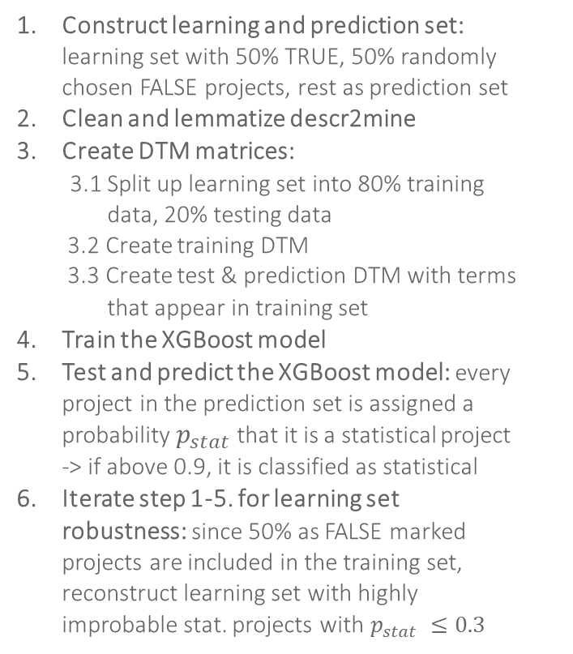

4. Text mining of long descriptions
Long descriptions are analyzed since a project’s title might be very generic, but it’s long descriptions could clearly show a statistics or gender focus
Text mining
Construct learning and prediction set: learning set with 50% TRUE, 50% randomly chosen FALSE projects, rest as prediction set
Clean and lemmatize descr2mine
Create DTM matrices:
3.1 Split up learning set into 80% training
data, 20% testing data
3.2 Create training DTM
3.3 Create test & prediction DTM with terms
that appear in training set
Train the XGBoost model
Test and predict the XGBoost model: every project in the prediction set is assigned a probability $p_{stat}$that it is a statistical project -> if above 0.9, it is classified as statistical
Iterate step 1-5. for learning set robustness: since 50% as FALSE marked projects are included in the training set, reconstruct learning set with highly improbable stat. projects with $p_{stat} ≤0.3$
Reduced CRS data
Text mining data set
long_language
statistics
descr2mine
text_id
long_language
text_id
statistics
Language filtering: separate classification for each language
Drop duplicated text ids: to analyze the same description only once
Manual filter correction: for projects with statistics = TRUE, some projects manually corrected*
….
342ex en TRUE The last…
ee455 en TRUE Building..
290r4 en FALSE A land …
3345t en FALSE Mice…
3369w en FALSE Sexual …
:
:
342ex en TRUE
ee455 en TRUE
33x5d sa FALSE
290r4 NA FALSE
3345t es TRUE
3qq56 nl FALSE
44qw3 ol FALSE
4550e NA FALSE
3369w NA TRUE
:
:
learning set
prediction set
text_id
$$p_{stat}$$
text_mining_stat
statistics
322ex FALSE 0.922 TRUE
ee245 FALSE 0.23 FALSE
290r4 FALSE 0.899 FALSE
3345t FALSE 0.95 TRUE
3369w FALSE 0.123 FALSE
:
:
*currently only done for
200 en projects
Add detection filters to original
reduced data set acc. to text id

Slide 8
4.1 Technical aspects of text mining
For a gender classification, the “statistics” filter on the previous slide is exchanged for the “gender” filter from the title pattern matching. It would also be possible to use a combination of different identifiers such as the gen_donor as the “gender” filter, but a bias can be introduced this way.
The classification is based on a regularizing gradient boosting framework implemented in the XGBoost project. For a short but really good introduction into boosted trees, see the project documentation. For more information on gradient boosting, consider this. In this text mining classification, the algorithm learns the importance for each word (e.g. for gender “woman” with very high importance, “air” witch very low importance) and can thereby classify unknown projects based on the words in the description.
A few parameters were introduced for testing purposes or to speed up the process:
n_gram: if set to integers larger than one, the classification considers also word combinations of that length for the importance matrix (e.g. “information system” with high importance); high computation time for n_gram > 1 due to exponential growth of DTMs
full_learning_percent: take only x% of the full learning set if the size is too large for RAM (only for en & gender)
neg_sample_fraction: Fraction of negatively marked projects to positively marked in the learning set
frac_pred_set: use only x% of full prediction set; can be used to speed up the whole process for testing purposes
save_fit_xgb & load_fit_xgb: can be used to save the fitted model in the second iteration; use load to load a previously fitted model to save computation time
split_pred & n_pred_sets: for splitting up the prediction set into n_pred_sets data frames to handle very large prediction sets; preserves RAM when predictions are made since only a n_pred_sets^{th} of the full prediction set has to be held in the memory at the same time.

Slide 9
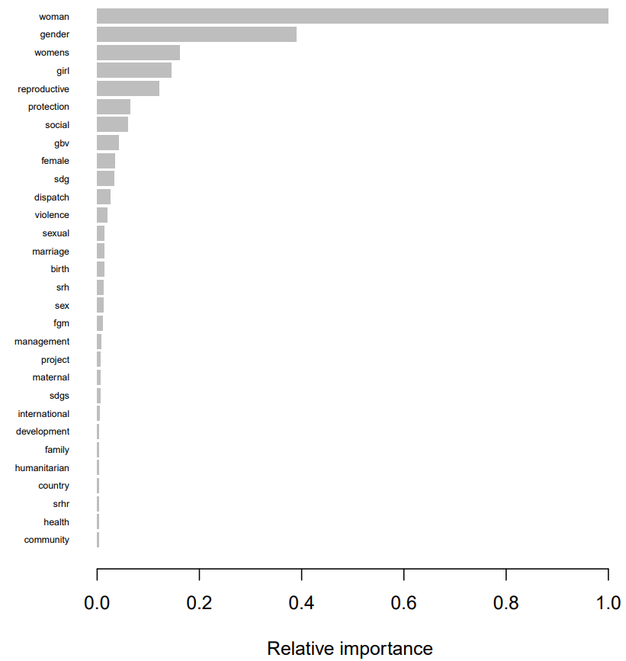
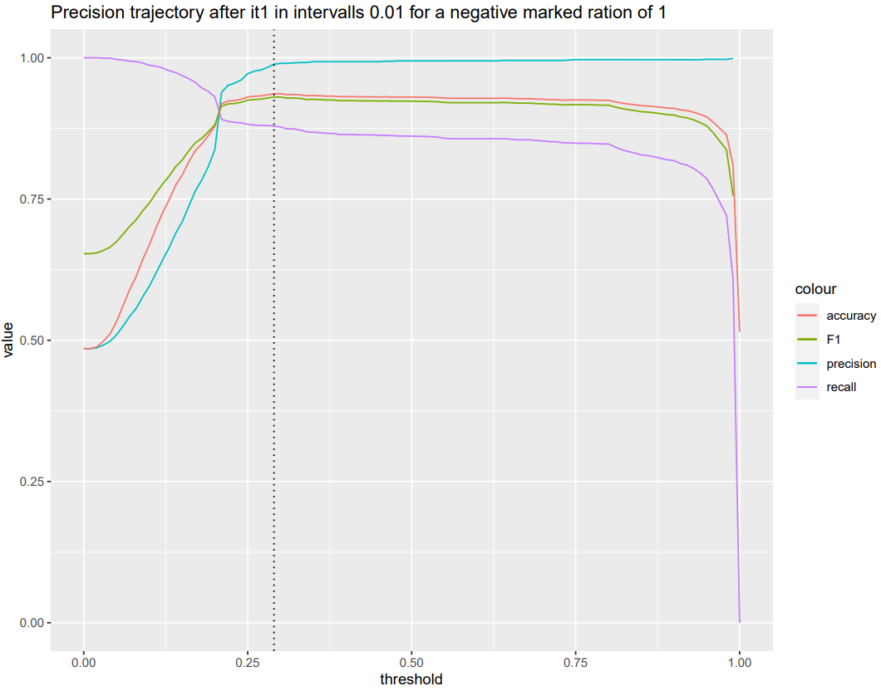
4.2 Performance checks
The most insight into the way the classification works is through the importance matrix. Through the relative importance of each word, the probability score for a long description can be reconstructed.
For checking the quality of the classification and determining the optimal threshold, the precision, accuracy and recall are of interest.

Slide 10
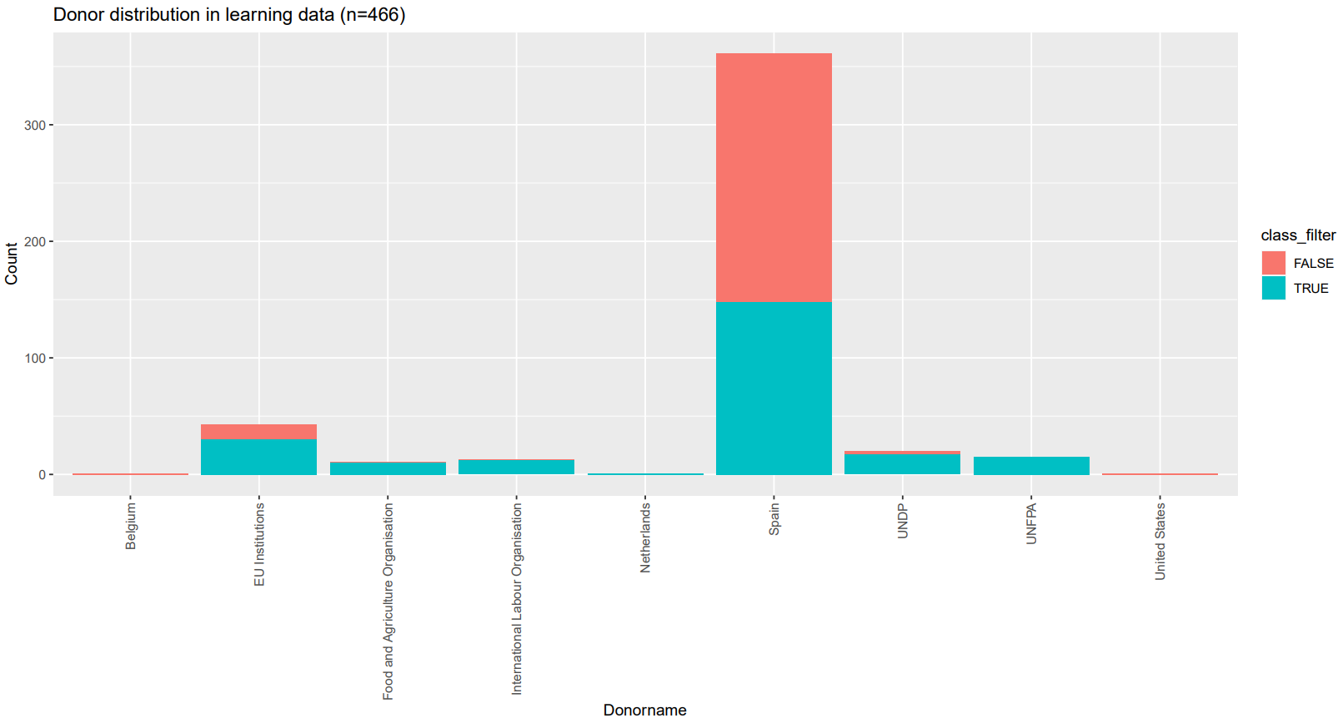
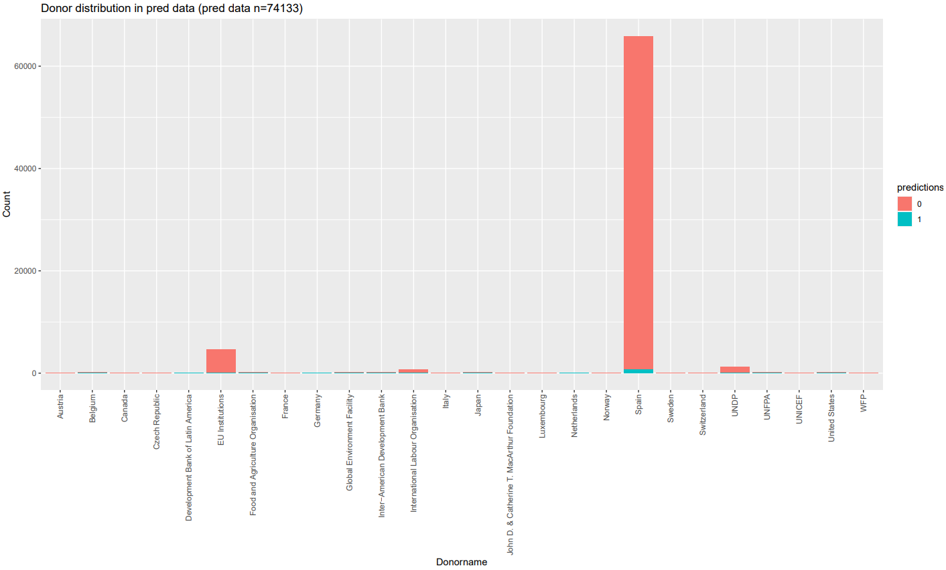
4.2 Performance checks
To avoid biases, it is interesting to check the donor distribution. If a certain donor is overrepresented, or in the case of a minority language, a projects in the learning and prediction set stem from a spurious donor, it can be detected.
for Spanish statistical classification

Slide 11
3.1 Minority language treatment for text mining
Full CRS
Title language
Long description language
Price deepL long
en
en
stemming
de
translate
de
German
35 - 40 EUR
lemma
en
translate
de
stemming
de
en
stemming
es
stemming
es
Spanish
lemma
en
stemming
es
stemming
es
en
stemming
fr
stemming
fr
French
stemming
lemma
en
fr
stemming
fr
en

